Slide 1

Project Presentation
on
Real Time Object Detection using Deep Learning
Presented By :
Nitin Singh (1809710065)
Aryan Yadav (1809710027)
Ashutosh Prajapati (1809710028)
Guided By
Mr. Ajeet Kumar Bhartee
Department of Computer Science & Engineering Galgotias College of Engineering & Technology , Greater Noida
Dr. A.P.J. Abdul Kalam Technical University, Lucknow, Uttar Pradesh

Slide 2
Outline
Introduction
Problem Statement
Objective
Literature Review
Proposed Work
DataSet Used
Tools Used
Implementation
Result
Conclusion
Future Scope
References

Slide 3
Introduction
Our project is to build a real time object detector based on deep learning.
Object Detection allow us to identify and locate objects in a video or image.
There are various applied use of Object Detection :
Self-driving cars
Video surveillance
Animal detection in agriculture
Medical feature detection in Healthcare

Slide 4
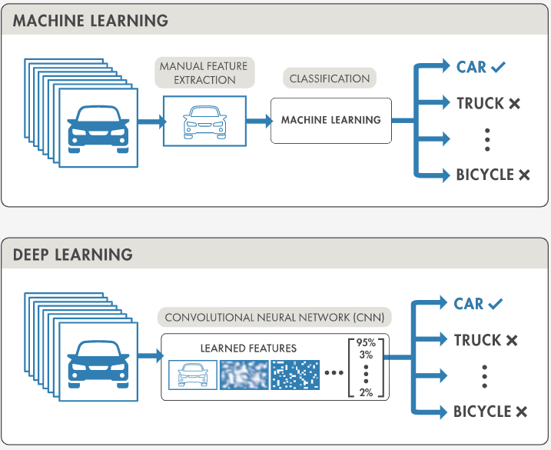
Object detection techniques [2]

Slide 5
Problem Statement
Traditional models are only able to extract low-level feature information and not good in case of multiple object detection. It is a complex to do and balancing the relationship between accuracy and computing costs is difficult task.
Detection of object in real-time means within a time limit is complex task to do.
Deep Learning based approach is faster as well as more accurate compared to these traditional approach.
Utilization of Learning of pre trained model instead of training model from scratch.

Slide 6
Objective
Improving object classification and localization : Models can classify as well as locate the position of objects with high accuracy.
Improving Speed for real-time detection : Building a model which can perform the complex computation like multiple scale object feature mapping and position detection within a limited interval with good speed and accuracy.
Building a multiple scale object detection model : An Image contains multi scale objects so models needs to detect all these objects accurately.
Removing class imbalance problem : This problem occur when there is a unequal distribution of classes in the training datasets.
Utilizing Learning pre trained optimise model for detecting different class of object

Slide 7
Literature Review
S.No | Papers | Methods | Findings | Research Gap
1. | D.G. Lowe. Distinctive Image Features from Scale-Invariant Keypoints. IJCV 2004 | SIFT based approach | SIFT approach allows to extract distinctive in variant features from object we are trying to detect. By using a set of training images a database of key-points features can be generated | It is mathematically complicated and computationally heavy
2. | Serge Belongie, Jitendra Malik. Shape Matching and Object Recognition using Shape Context. IEEE transactions on Pattern Analysis and Machine Intelligence. April 2002 | Shape Context approach | Approach consists of sampling the edges of object into point of interest, and capturing the distribution of the sampled points on the shape with respect to the given point of shape. | Computationally expensive and not suited for large databases.
3. | Navneet Dalal, Bill Triggs. Histograms of Oriented Gradients for Human Detection. CVPR 2005 | Histogram of oriented gradients (HOG) | HOG descriptors as a template for human detection works well when used with a linear classifier, trained with positive and negative scaled images. But the descriptor is not scale invariant | Analysis of multi-scale objects is difficult in this approach.

Slide 8
S.No | Papers | Methods | Findings | Research Gap
4 | V, Murugan; V.R, Vijaykumar; A, Nidhila (2019). A Deep Learning RCNN Approach for Vehicle Recognition in Traffic Surveillance System. | R-CNN | Use Selective search algorithm to get 2k region proposals and use it as CNN input for object detection. | Time Consuming, not suitable in real-time detection, No learning at any stage in this approach.
5 | Htet, K. S., & Sein, M. M. (2020). Event Analysis for Vehicle Classification using Fast RCNN. 2020 | Fast R-CNN | Feed image to CNN get feature map then find region proposal from it and wrap them into square which move in ROI layer and then get classify. | Better then R-CNN but it also use selective search reduces its efficiency
6 | Yin, X., Yang, Y., Xu, H., Li, W., & Deng, J. (2020). Enhanced Faster-RCNN Algorithm for Object Detection in Aerial Images. 2020 | Faster R-CNN | It use a separate network is used for region proposals and other things are same as the previous model. | It is expensive and used in real time but not very fast in detection.

Slide 9
Proposed Work
The approach utilized in this project is YOLO(You Only Look Once).
YOLO algorithm works using following three techniques:
Residual Blocks:- The image is divided into various grids. Each grid has a dimension of S x S. The following image shows how an input image is divided into grids.
Bounding box regression:- Outline that highlights an object in an image is termed as bounding box. In YOLO single bounding box regression to predict the height, width, center, and class of objects.
Intersection over union (IOU):- It is a phenomenon in object detection that describes overlapping of boxes. YOLO uses IOU in order to find the best fitting boundary box and eliminating all other less feasible overlap boxes.
Area bounded in intersection regions of real and predicted box
IOU = -------------------------------------------------------------------------------------
Area bounded in Union regions of real and predicted box

Slide 10
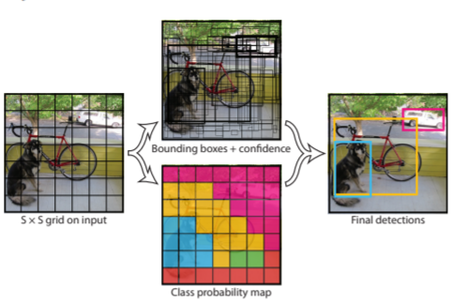
Following image show the application of all three combined techniques to produce the final detection results
Fig 2 : Proposed Framework [1]

Slide 11
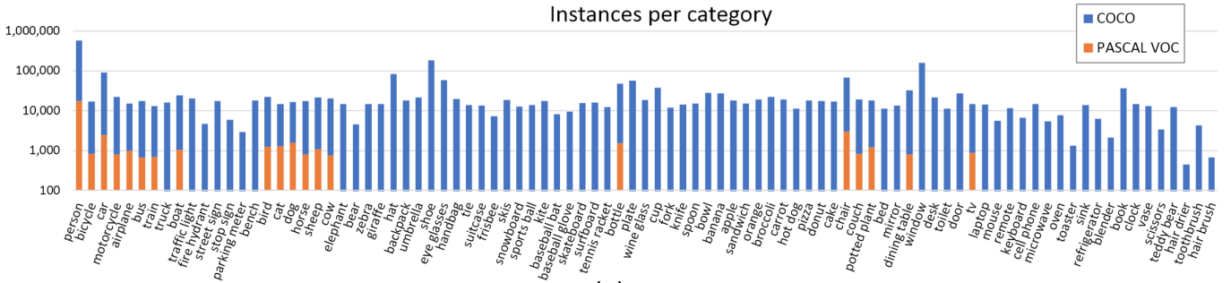
Dataset Used
COCO is a large-scale object detection, segmentation.
MS Coco is a dataset released by Microsoft in 2015.
The images in the Common Objects in Context (COCO) dataset are everyday objects captured from everyday scenes.
The COCO dataset has 80 object categories.

Slide 12
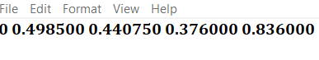
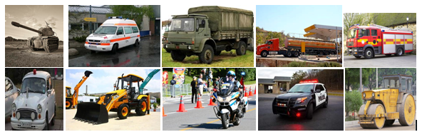
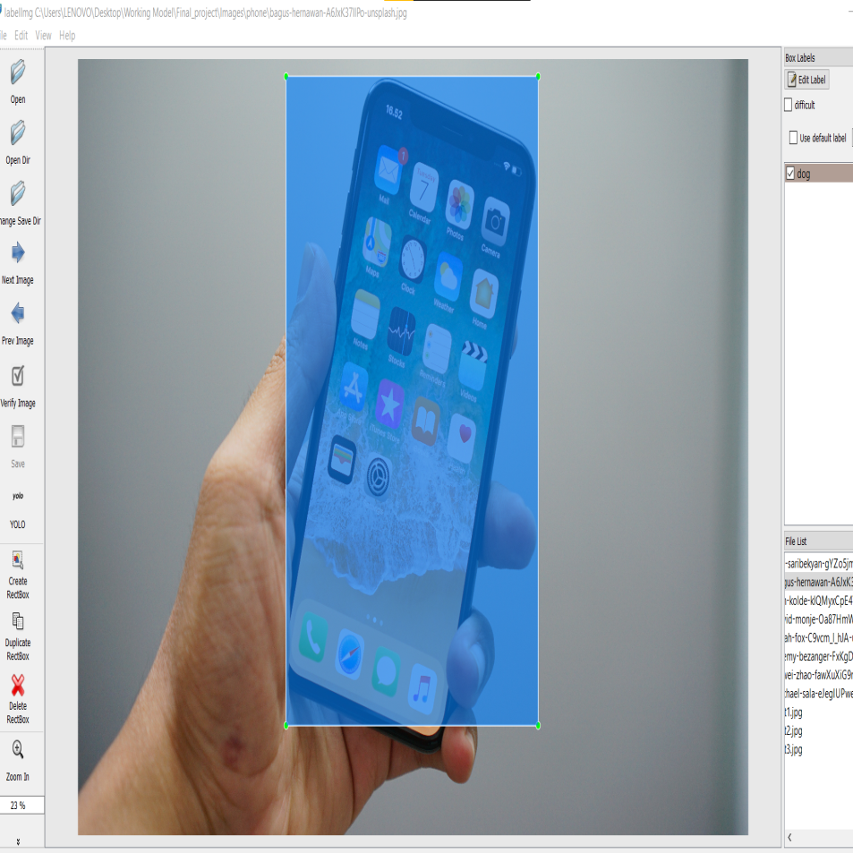
Custom Dataset consist 800 vehicle images belong to 10 different classes.
Custom Dataset have 10 different class of vehicle.
Label images in the input format of Yolo using labelimg tool
object-class x y width height

Slide 13
Tools Used
Python
Pycharm IDE
OpenCV
Coco(Common object in Context) dataset
Custom Dataset (10 different vehicle class)
Yolo v3
LabelImg
Google Colab

Slide 14
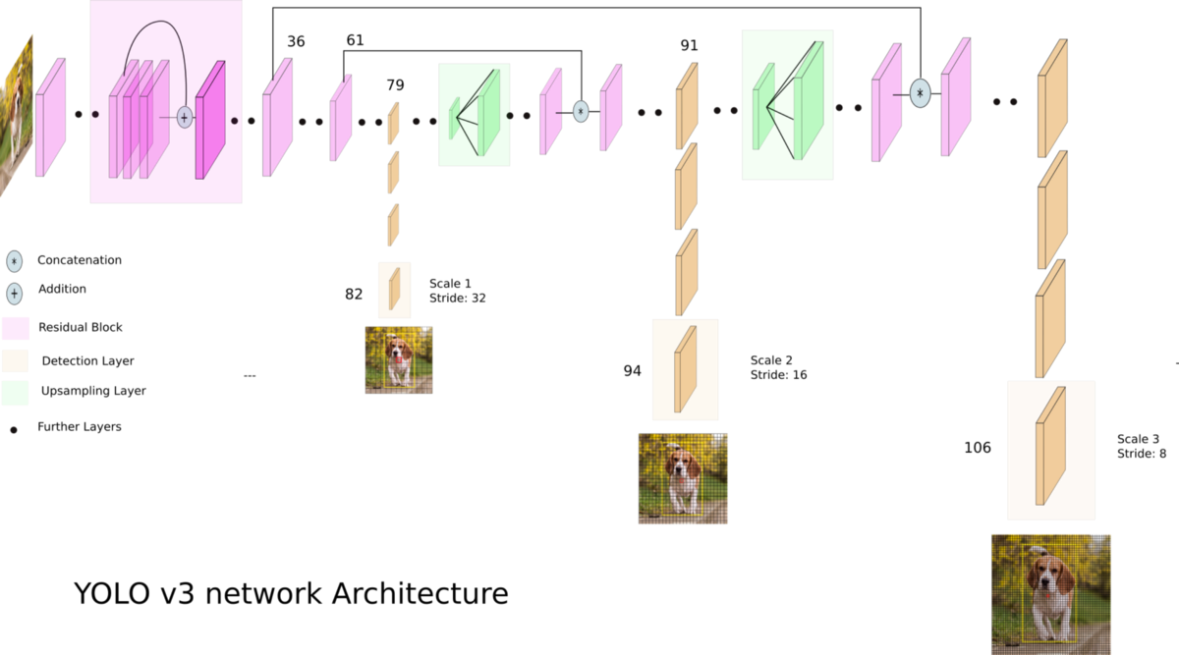
Implementation
[8]

Slide 15
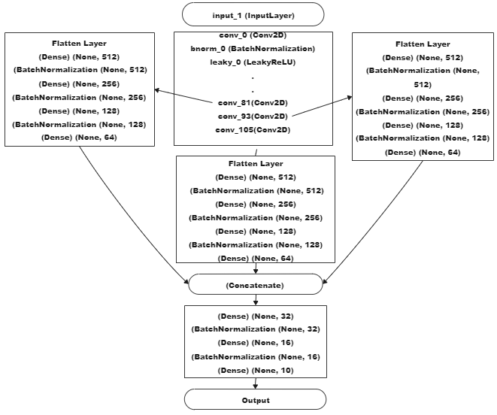
Proposed Model

Slide 16
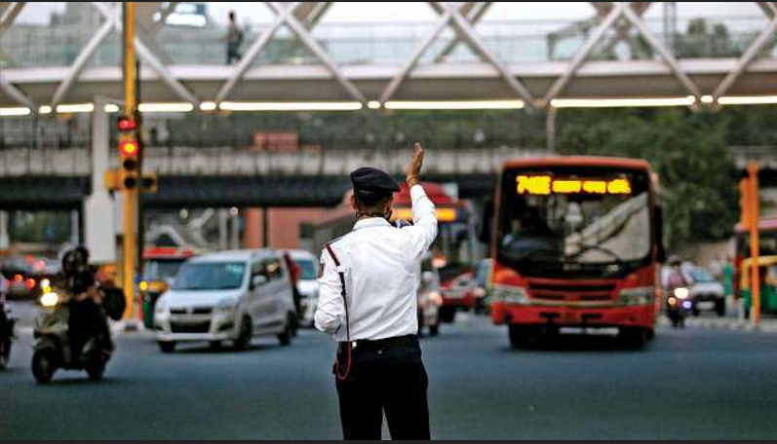
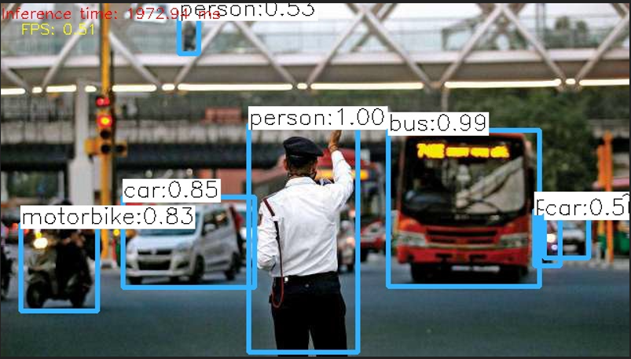
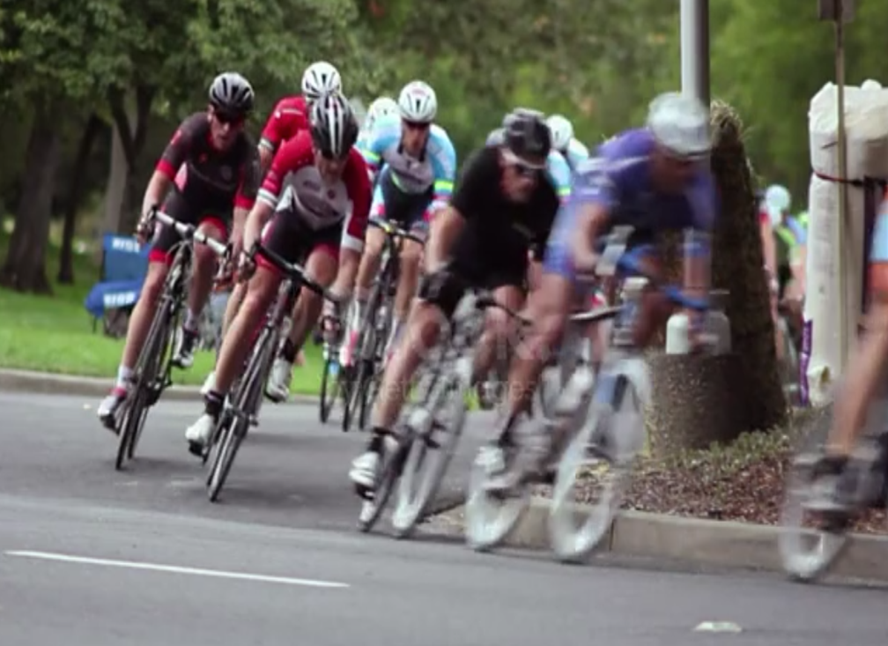
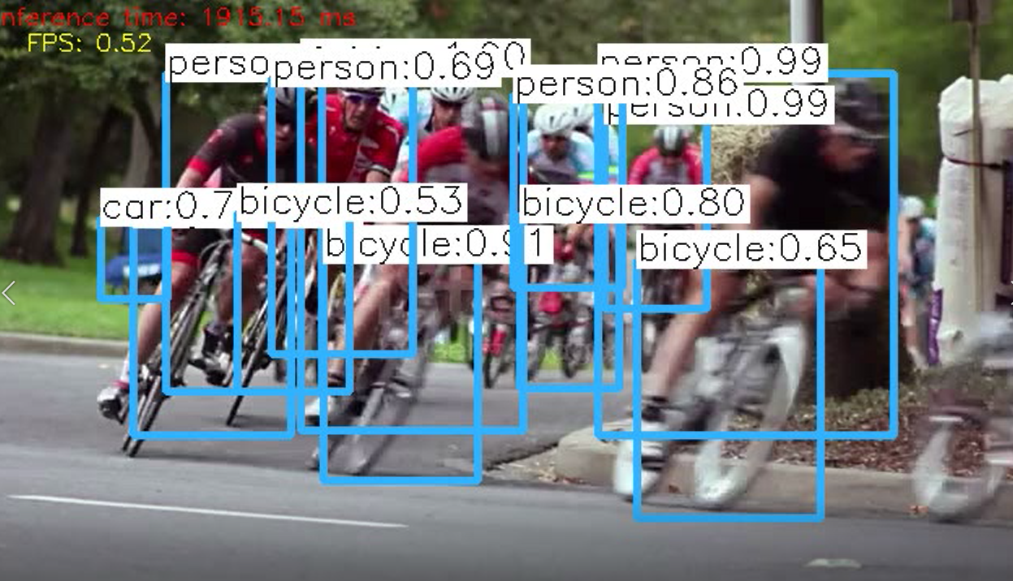

Slide 17
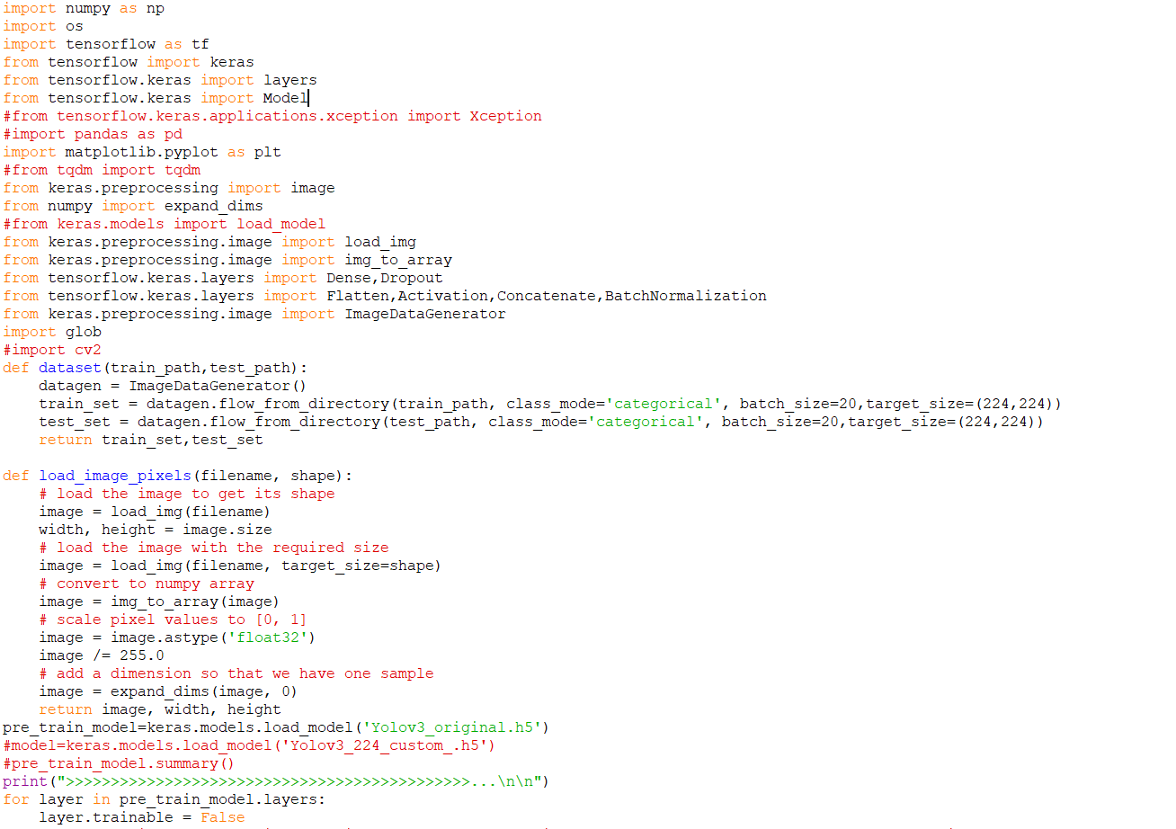
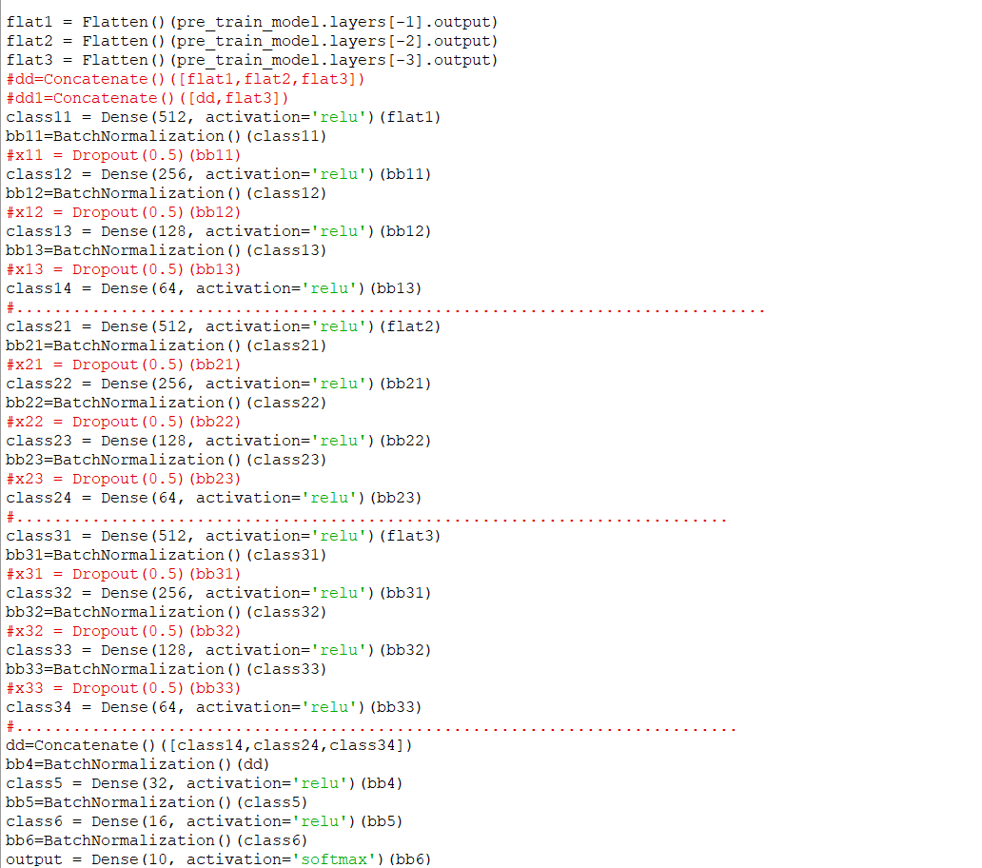

Slide 18
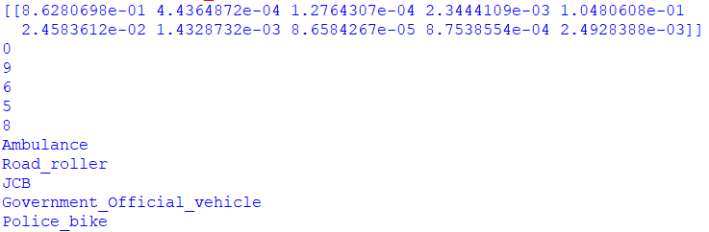
Result

Slide 19
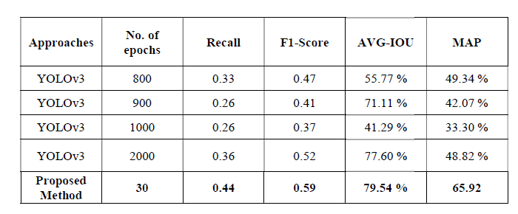

Slide 20
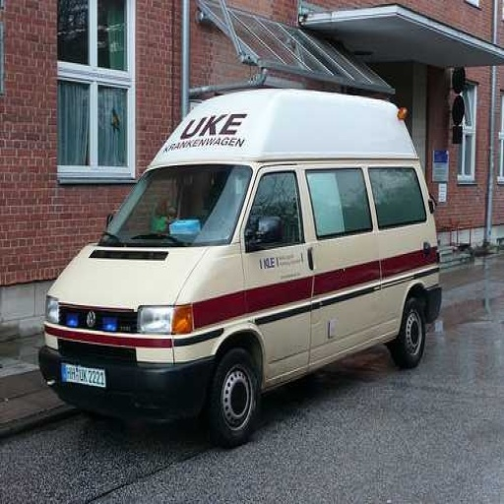
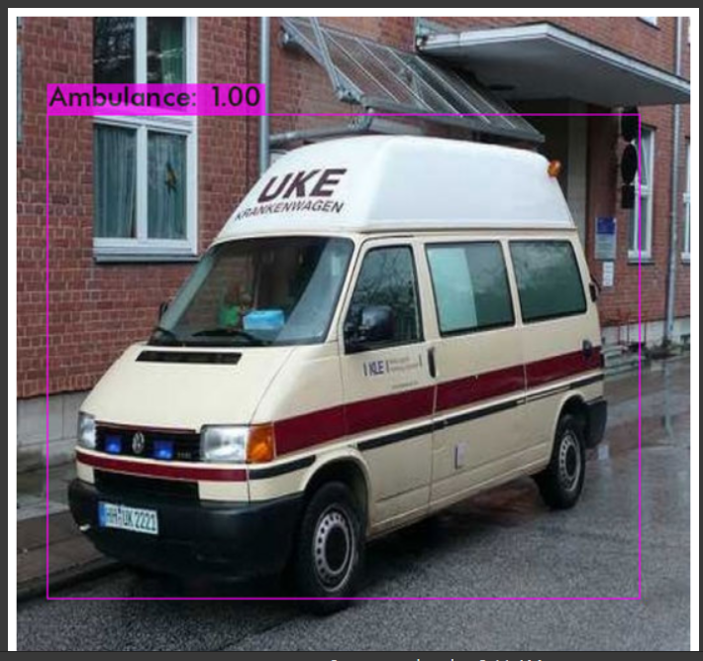

Slide 21
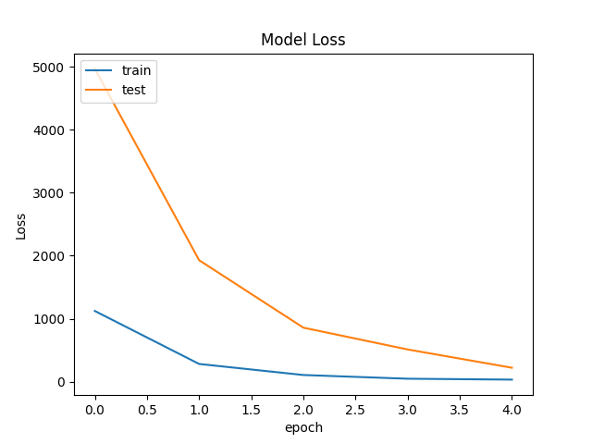
Chart Shows the variation of training and testing loss with the number of epoch

Slide 22
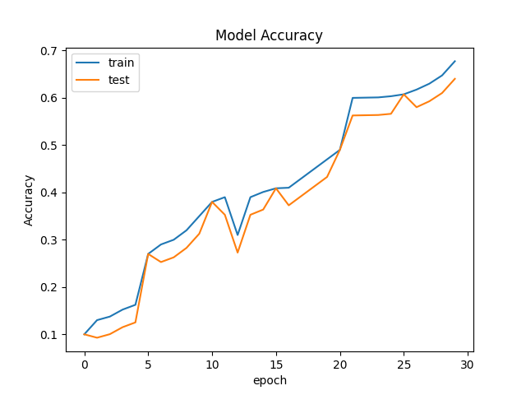
Chart Shows the variation of accuracy with the number of epoch

Slide 23
Conclusion
This technique provides improved detection results compared to other object detection techniques such as SIFT, Shape context and Hog based approach.
Instead of training model from scratch we used learning of a pre trained model which saves time and computation power.
This method can give good detection accuracy with small dataset.
Required less time for training.
Can be trained using low computing devices.

Slide 24
FUTURE SCOPE
Accuracy of Extended Yolov3 model can be improved by improving the dataset used for model training and increasing the training time.
Used in traffic management systems.
Implement and use this model in real life like car driving, surveillance system, robotics etc.
For Night time visual tracking, night vision mode should be available as an inbuilt feature in the CCTV camera.

Slide 25
References
[1] Lowe, David G. "Object recognition from local scale-invariant features."Proceedings of the seventh IEEE international conference on computer vision. Vol. 2.Ieee, 1999
[2] Belongie, Serge, Jitendra Malik, and Jan Puzicha. "Shape matching and object recognition using shape contexts." IEEE transactions on pattern analysis and machine intelligence 24.4 (2002): 509-522.
[3] Dalal, Navneet, and Bill Triggs. "Histograms of oriented gradients for human detection." 2005 IEEE computer society conference on computer vision and pattern recognition (CVPR'05). Vol. 1. Ieee, 2005.
[4] Redmon, Joseph, et al. "You only look once: Unified, real-time object detection."Proceedings of the IEEE conference on computer vision and pattern recognition. 2016.
[5] Murugan, V., V. R. Vijaykumar, and A. Nidhila. "A deep learning RCNN approach for vehicle recognition in traffic surveillance system." 2019 International Conference on Communication and Signal Processing (ICCSP). IEEE, 2019.
[6] Jin, Ying-Hui, et al. "Chemoprophylaxis, diagnosis, treatments, and discharge management of COVID-19: An evidence-based clinical practice guideline (updated version)." Military Medical Research 7.1 (2020): 1-33.
[7] Htet, Khaing Suu, and Myint Myint Sein. "Market Intelligence Analysis on Age Estimation and Gender Classification on Events with deep learning hyperparameters optimization and SDN Controllers." 2020 IEEE Conference on Computer Applications (ICCA). IEEE, 2020.
[8] Wang, Jintao, Wen Xiao, and Tianwei Ni. "Efficient object detection method based on improved YOLOv3 network for remote sensing images." 2020 3rd International Conference on Artificial Intelligence and Big Data (ICAIBD). IEEE, 2020.
[10] Roy, Shuvendu, and Md Sakif Rahman. "Emergency vehicle detection on heavy traffic road from cctv footage using deep convolutional neural network." 2019 International Conference on Electrical, Computer and Communication Engineering (ECCE). IEEE, 2019.

